Slide 1



以瀏覽器擴充套件
提升網頁事件觸發後HTML差異判斷之速度
Facilitating The Process Rate Of DifferenceDetermination Within HTML After Events Triggered In Web Page
國立臺北科技大學 資訊工程系
研究生 ： 廖昱翔 指導教授： 陳碩漢 博士
口試日期： 2022 / 07 / 18
Computer and Storage System Laboratory, CSS Lab

Slide 2
目錄
研究動機及目標
相關背景知識
HTML比對擴充元件設計與實作
案例分析
結論與未來研究方向
Computer and Storage System Laboratory, CSS Lab

Slide 3
目錄
研究動機及目標
相關背景知識
HTML比對擴充元件設計與實作
案例分析
結論與未來研究方向
Computer and Storage System Laboratory, CSS Lab

Slide 4
研究動機及目標
網頁自動化腳本(本頁介紹什麼是測試腳本[此為註解，正式版會刪除])
補圖或不補圖
Computer and Storage System Laboratory, CSS Lab

Slide 5
研究動機及目標
與網頁前端互動(本頁介紹互動的概念[此為註解，正式版會刪除])
補圖或不補圖
Computer and Storage System Laboratory, CSS Lab

Slide 6
研究動機及目標
XPath的組成(本頁介紹Xpath是什麼，大概怎麼用[此為註解，正式版會刪除])
補圖或不補圖
Computer and Storage System Laboratory, CSS Lab

Slide 7
研究動機及目標
如何設計穩定定高的XPath(本頁怎樣的XPath是強壯的穩定性高的[此為註解，正式版會刪除])
補圖或不補圖
Computer and Storage System Laboratory, CSS Lab

Slide 8
研究動機及目標
利用Xpath來判斷互動前後的狀態
找出元件變化屬性當成條件判斷
(本頁介紹Xpath如何判斷互動前後的狀態並應用在測試腳本中 [此為註解，正式版會刪除])
補圖或不補圖
Computer and Storage System Laboratory, CSS Lab

Slide 9
研究動機及目標
變化屬性尋找的困難
列舉情況*2
補圖或不補圖
Computer and Storage System Laboratory, CSS Lab

Slide 10
研究動機及目標
研究目標:找出能夠協助判斷使用者快速找出適合屬性或元件
補圖或不補圖
Computer and Storage System Laboratory, CSS Lab

Slide 11
目錄
研究動機及目標
相關背景知識
HTML比對擴充元件設計與實作
案例分析
結論與未來研究方向
Computer and Storage System Laboratory, CSS Lab

Slide 12
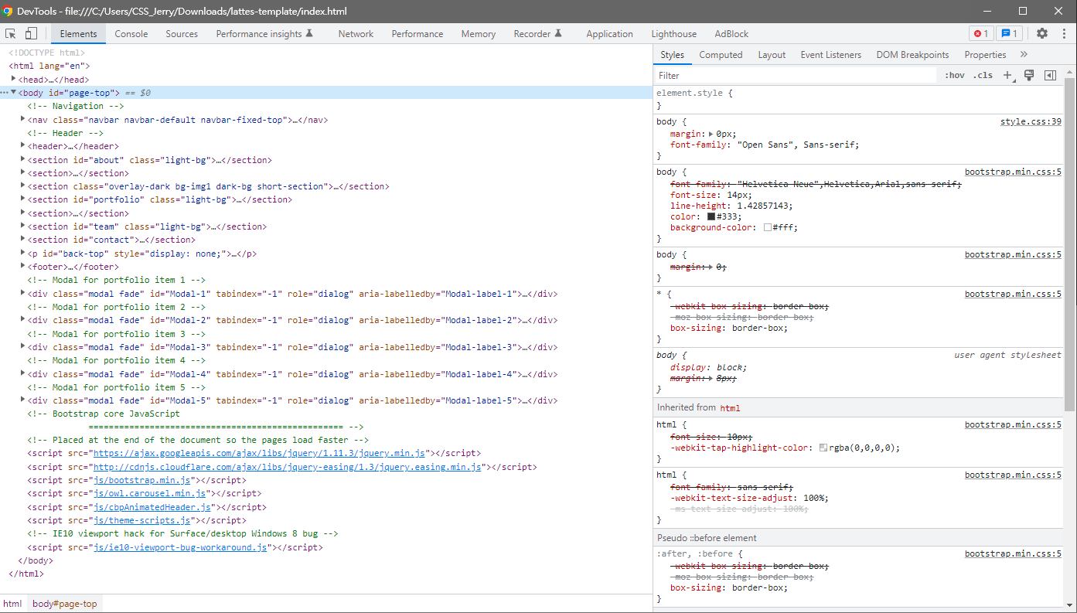
相關背景知識
開發者工具(本頁描述的樣子並說xpath都是用這個工具[此為註解，正式版會刪除])
Computer and Storage System Laboratory, CSS Lab

Slide 13
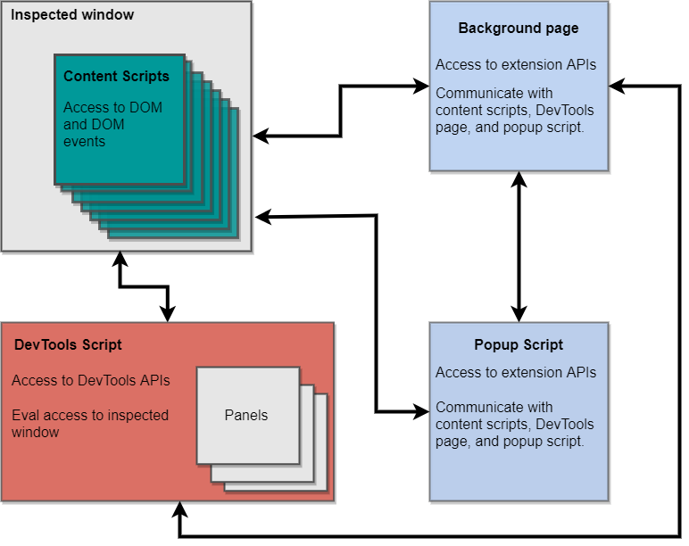
相關背景知識
擴充程式以及擴充程式腳本
Computer and Storage System Laboratory, CSS Lab

Slide 14
目錄
研究動機及目標
相關背景知識
HTML比對擴充元件設計與實作
案例分析
結論與未來研究方向
Computer and Storage System Laboratory, CSS Lab

Slide 15
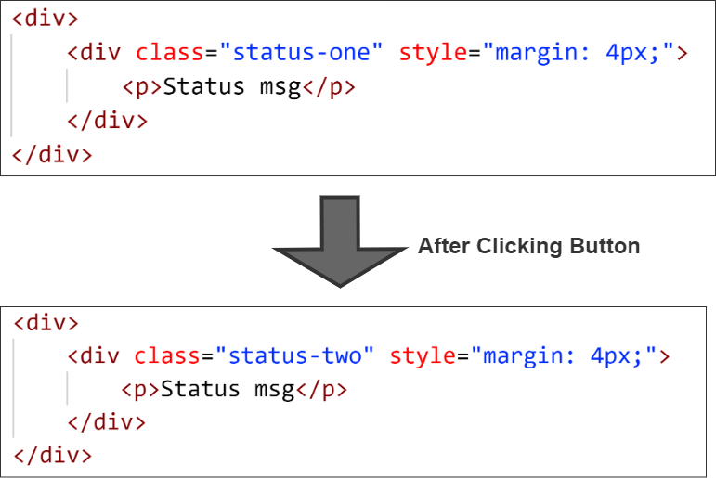
HTML比對擴充程式與實作
簡易敘述擴充程式適合使用情境(本頁描述可以在哪些情境下使用擴充程式[此為註解，正式版會刪除])
Computer and Storage System Laboratory, CSS Lab

Slide 16
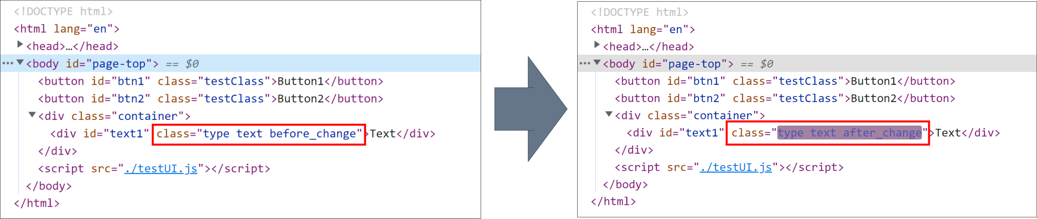
HTML比對擴充程式與實作
元件互動時HTML 快速變化 (本頁描述HTML中元件快速變化的情境[此為註解，正式版會刪除])
Computer and Storage System Laboratory, CSS Lab

Slide 17
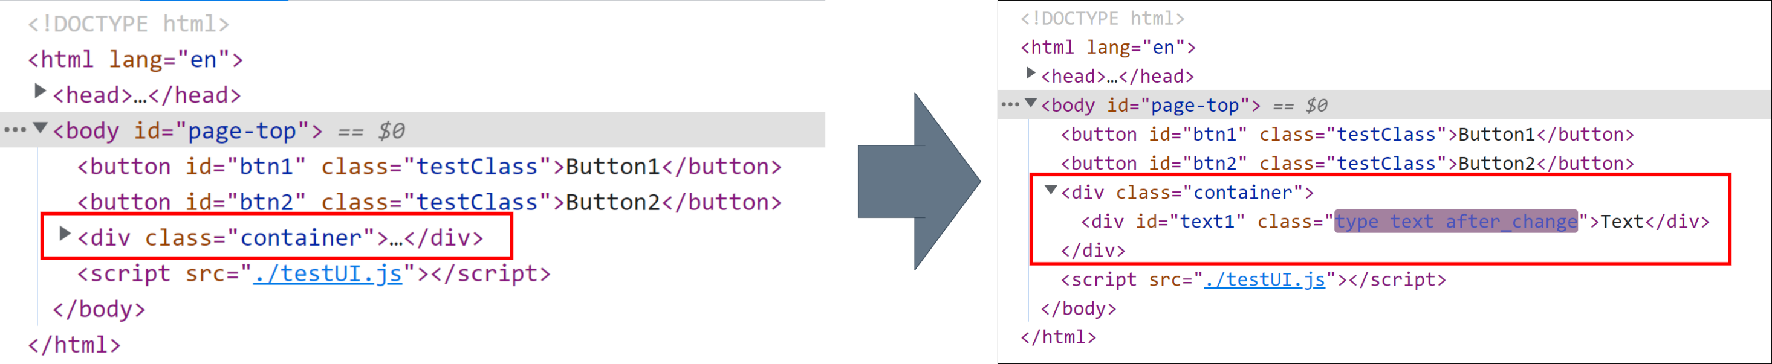
HTML比對擴充程式與實作
HTML多層元件未展開無變化提示(本頁描述HTML元件未展開時無變化提示之情境[此為註解，正式版會刪除])
Computer and Storage System Laboratory, CSS Lab

Slide 18
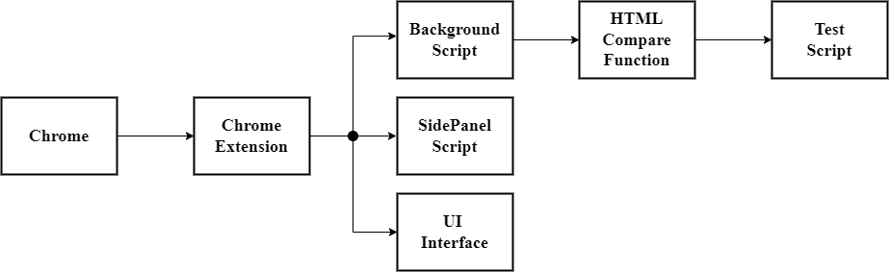
HTML比對擴充程式與實作
擴充元件系統架構(本頁描述 利用圖片來介紹本次擴充元件的系統架構[此為註解，正式版會刪除])
Computer and Storage System Laboratory, CSS Lab

Slide 19
HTML比對擴充程式與實作
HTML比對活動圖(本頁利用流程圖介紹HTML比對的演算法[此為註解，正式版會刪除])
Computer and Storage System Laboratory, CSS Lab

Slide 20
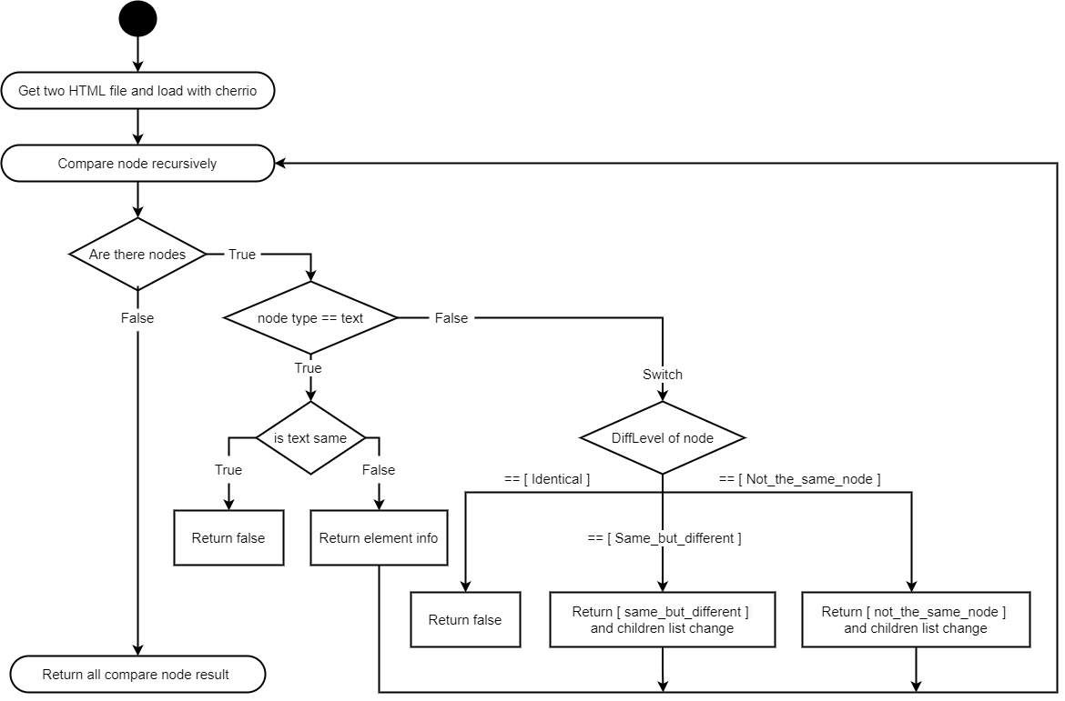
HTML比對擴充程式與實作
HTML比對活動圖(本頁利用流程圖介紹HTML比對的演算法[此為註解，正式版會刪除])
Computer and Storage System Laboratory, CSS Lab

Slide 21
HTML比對擴充程式與實作
判斷節點相異程度(本頁 介紹上頁流程圖中判斷節點相異程度的過程[此為註解，正式版會刪除])
Computer and Storage System Laboratory, CSS Lab

Slide 22
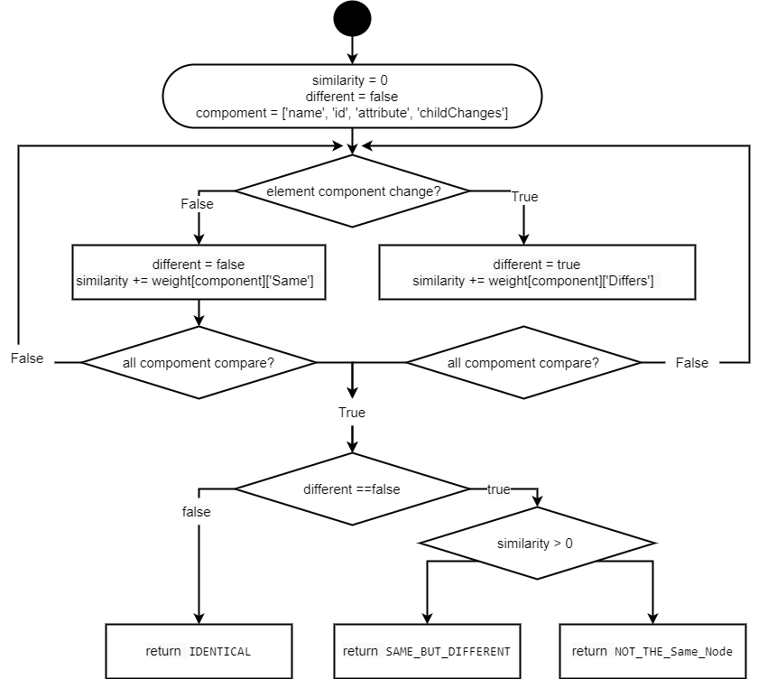
HTML比對擴充程式與實作
Computer and Storage System Laboratory, CSS Lab

Slide 23
HTML比對擴充程式與實作
比對後的輸出結果(本頁 介紹上頁流程圖中 最後的輸出結果要如何輸出的[此為註解，正式版會刪除])
補圖或不補圖
Computer and Storage System Laboratory, CSS Lab

Slide 24
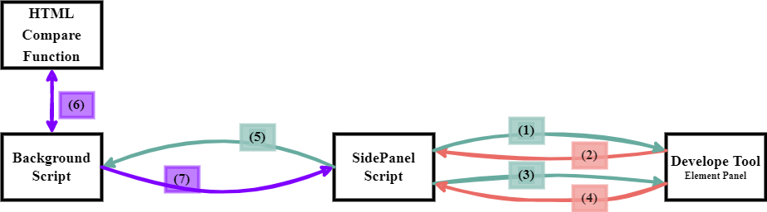
HTML比對擴充程式與實作
擴充程式腳本溝通(本頁 介紹上頁流程圖中 最後的輸出結果要如何輸出的[此為註解，正式版會刪除])
SidePanel Script
Background Script
Computer and Storage System Laboratory, CSS Lab

Slide 25
HTML比對擴充程式與實作
擴充程式腳本溝通(本頁 介紹上頁流程圖中 最後的輸出結果要如何輸出的[此為註解，正式版會刪除])
SidePanel Script
Background Script
Computer and Storage System Laboratory, CSS Lab

Slide 26
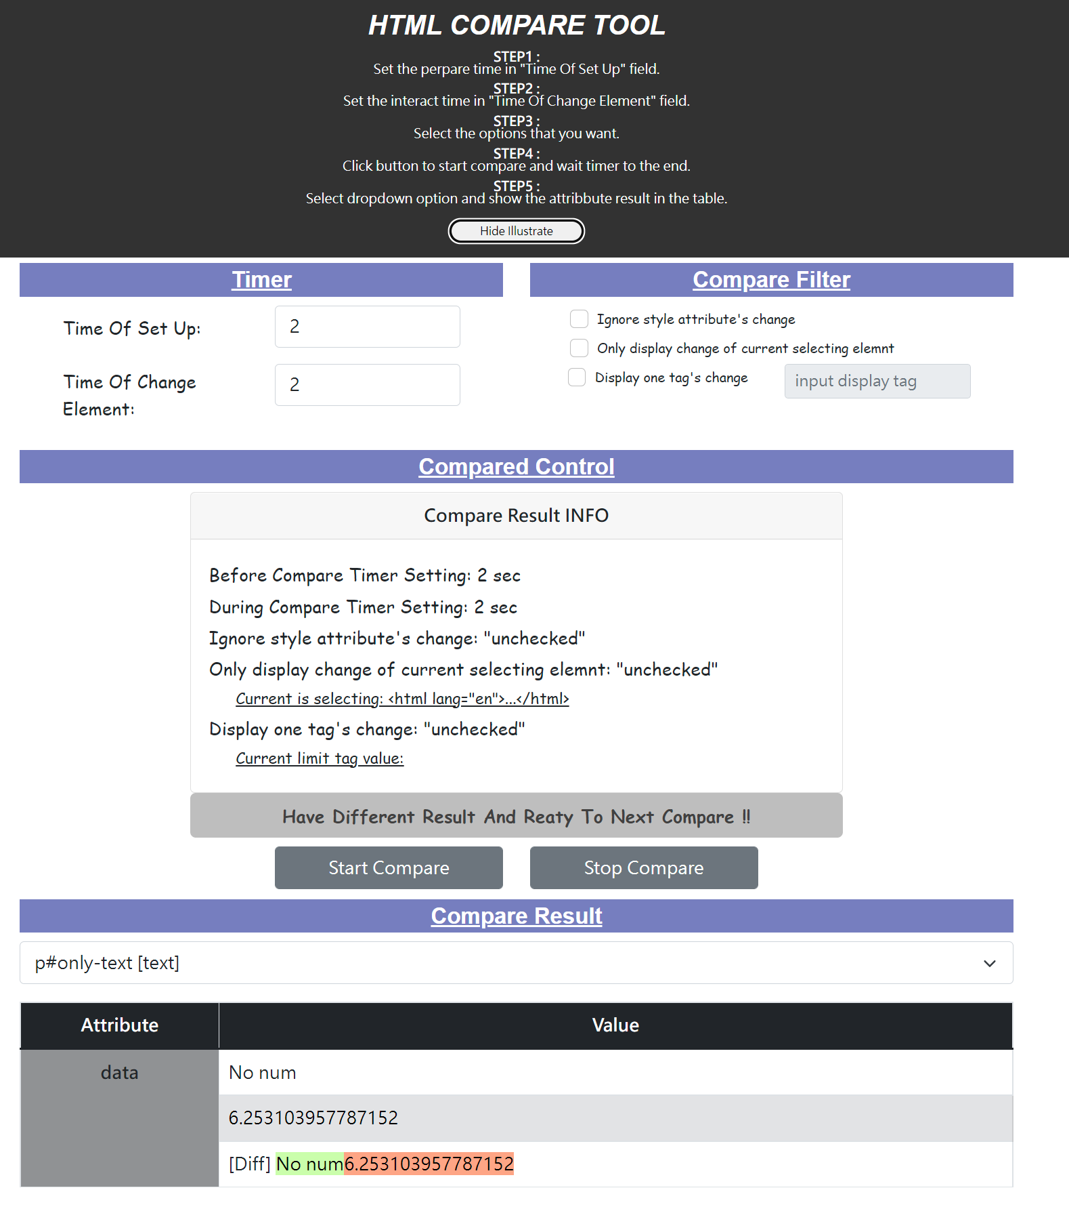
HTML比對擴充程式與實作
UI/UX介面
Illustrate
Timer
Time Of Set Up
Time Of Change Element
Options
Compare Control
Compare Result
Computer and Storage System Laboratory, CSS Lab

Slide 27
HTML比對擴充程式與實作
UI/UX介面
Illustrate
Timer
Time Of Set Up
Time Of Change Element
Options
Compare Control
Compare Result
Computer and Storage System Laboratory, CSS Lab

Slide 28
HTML比對擴充程式與實作
UI/UX介面
Illustrate
Timer
Time Of Set Up
Time Of Change Element
Options
Compare Control
Compare Result
Computer and Storage System Laboratory, CSS Lab

Slide 29
HTML比對擴充程式與實作
UI/UX介面
Illustrate
Timer
Time Of Set Up
Time Of Change Element
Options
Compare Control
Compare Result
Computer and Storage System Laboratory, CSS Lab

Slide 30
HTML比對擴充程式與實作
UI/UX介面
Illustrate
Timer
Time Of Set Up
Time Of Change Element
Options
Compare Control
Compare Result
Computer and Storage System Laboratory, CSS Lab

Slide 31
HTML比對擴充程式與實作
UI/UX介面
Illustrate
Timer
Time Of Set Up
Time Of Change Element
Options
Compare Control
Compare Result
Computer and Storage System Laboratory, CSS Lab

Slide 32
目錄
研究動機及目標
相關背景知識
HTML比對擴充元件設計與實作
案例分析
結論與未來研究方向
Computer and Storage System Laboratory, CSS Lab

Slide 33
案例分析
案例實驗設計
案例一：Hover 購物車圖示後出現購物車下拉式畫面
案例二：點擊搜尋框後，僅需要了解該元件屬性變化
案例三：網頁中畫面定時更換內容
案例四：點擊上方導覽列跳轉到該類別畫面
案例五：互動後當下網頁畫面無變化
Computer and Storage System Laboratory, CSS Lab

Slide 34

案例分析
案例一：Hover 購物車圖示後出現購物車下拉式畫面
Computer and Storage System Laboratory, CSS Lab

Slide 35
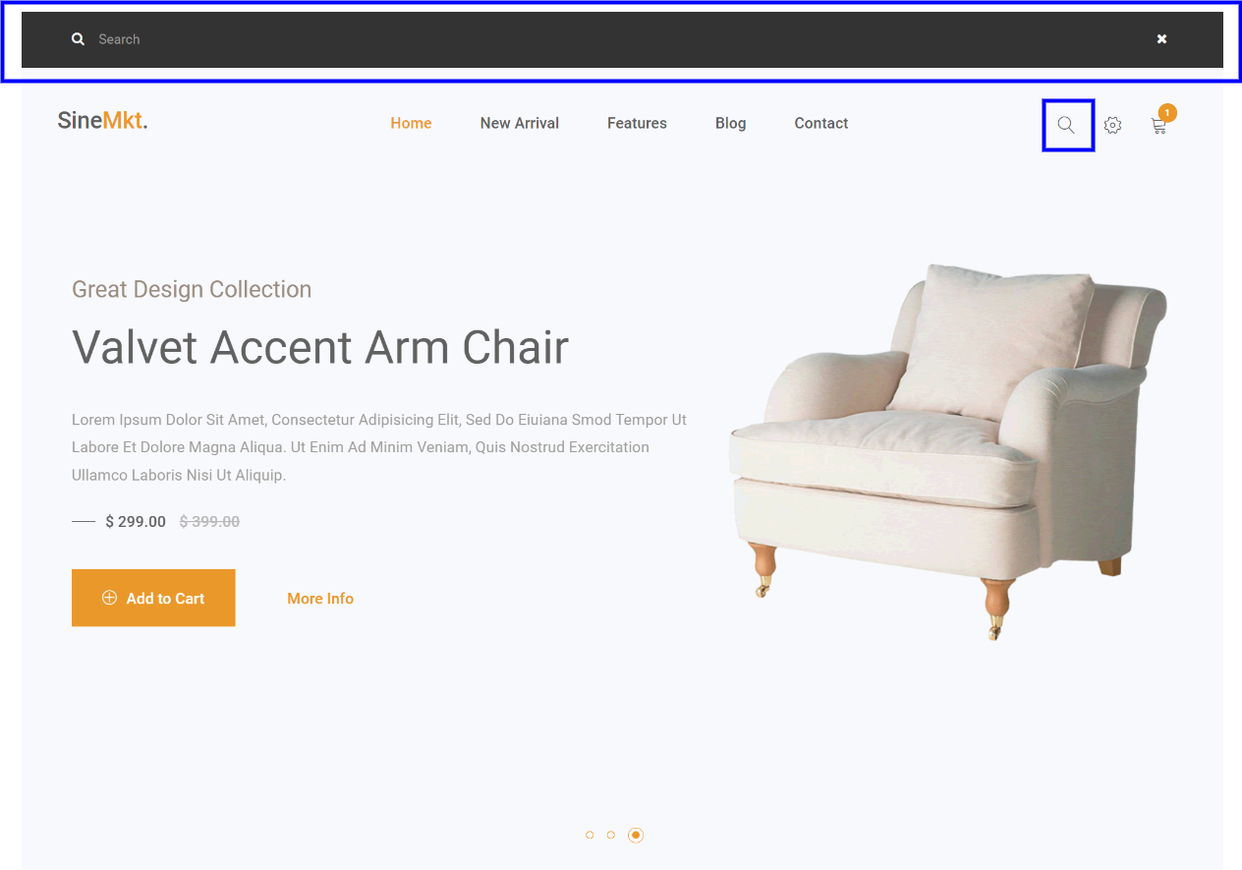
案例分析
案例二：點擊搜尋框後，僅需要了解該元件屬性變化
Computer and Storage System Laboratory, CSS Lab

Slide 36
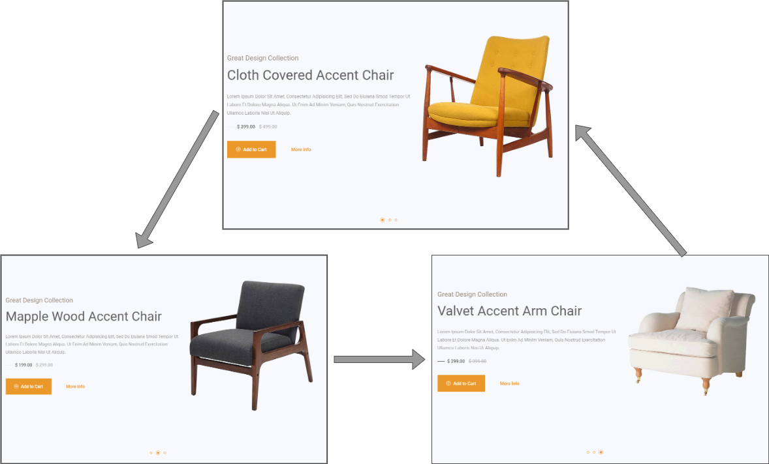
案例分析
案例三：網頁中畫面定時更換內容
Computer and Storage System Laboratory, CSS Lab

Slide 37
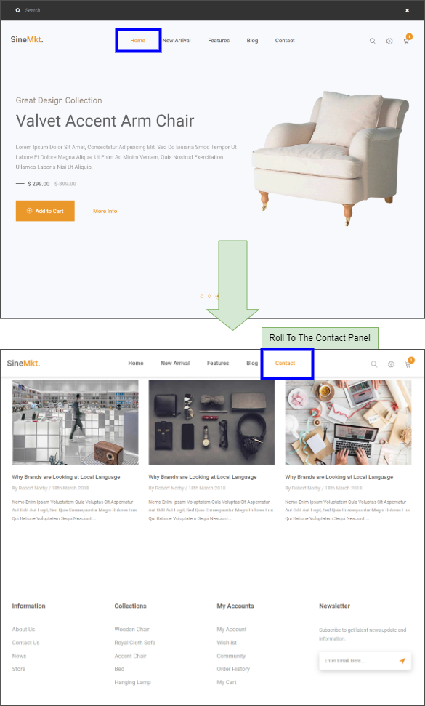
案例分析
案例四：點擊上方導覽列跳轉到該類別畫面
Computer and Storage System Laboratory, CSS Lab

Slide 38

案例分析
案例五：互動後當下網頁畫面無變化
Computer and Storage System Laboratory, CSS Lab

Slide 39
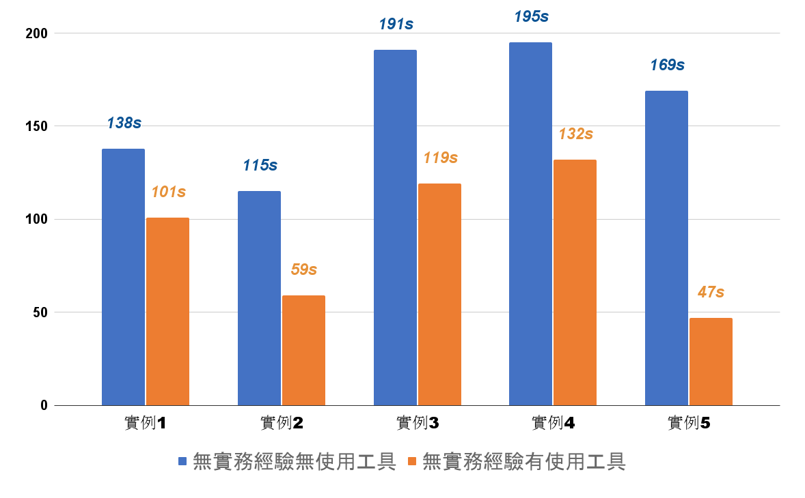
案例分析
實驗數據分析(無相關經驗人員實例操作時間比較)
Computer and Storage System Laboratory, CSS Lab

Slide 40
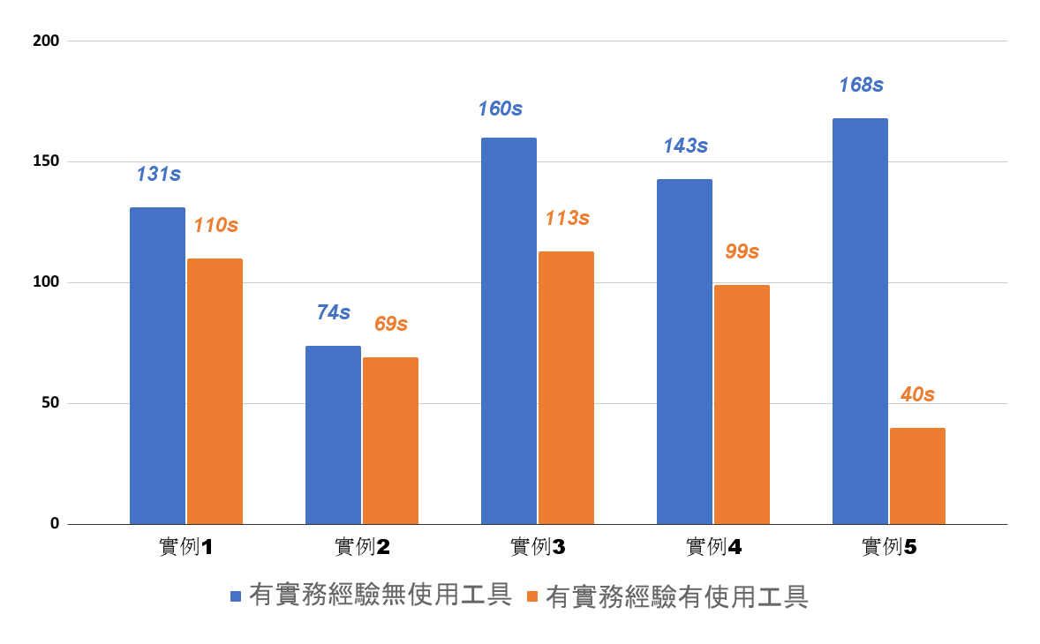
案例分析
實驗數據分析(有相關經驗實驗人員實例操作時間比較)
Computer and Storage System Laboratory, CSS Lab

Slide 41
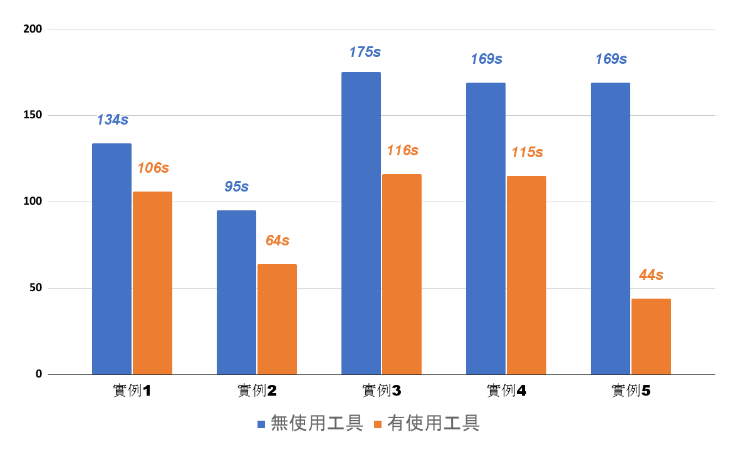
案例分析
實驗數據分析(全體實驗人員實例操作時間比較)
Computer and Storage System Laboratory, CSS Lab

Slide 42
目錄
研究動機及目標
相關背景知識
HTML比對擴充元件設計與實作
案例分析
結論與未來研究方向
Computer and Storage System Laboratory, CSS Lab

Slide 43
結論與未來研究方向
未來方向
比較節點相異等級之演算法
比對相異之元件自動跳轉到Develope Tool 中Element 頁面並標記
比對結果過濾功能新增
紀錄多個狀態的HTML
UI/UX 介面美化及操作更人性化
Computer and Storage System Laboratory, CSS Lab

Slide 44
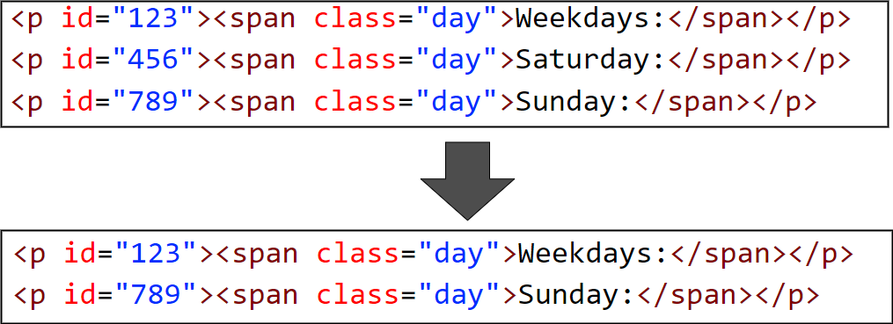
結論與未來研究方向
比對相異之元件自動跳轉到Develope Tool 中Element 頁面並標記
Computer and Storage System Laboratory, CSS Lab

Slide 45
結論與未來研究方向
未來方向
比較節點相異等級之演算法
比對相異之元件自動跳轉到Develope Tool 中Element 頁面並標記
比對結果過濾功能新增
紀錄多個狀態的HTML
UI/UX 介面美化及操作更人性化
Computer and Storage System Laboratory, CSS Lab

Slide 46
Q & A
Computer and Storage System Laboratory, CSS Lab

Slide 47





工作概述
PART.1
ZHENG TI GONG ZUO GAI SHU
Distant Time by Rabindranath. I know not from what distant time thou art ever coming nearer to meet me. I know not from what distant time. thou art ever
coming nearer to meet me.

Slide 48


工作概述
Please enter the title content
1,572
4,173
输入标题文本
输入标题文本
Distant Time by Rabindranath. I know not from what distant time .thou art ever coming nearer to meet me. I know not from what distant time .
Distant Time by Rabindranath. I know not from what distant time .thou art ever coming nearer to meet me. I know not from what distant time .
输入标题文本
输入标题文本
Distant Time by Rabindranath. I know not from what distant time .thou art ever coming nearer to meet me. I know not from what distant time .
Distant Time by Rabindranath. I know not from what distant time .thou art ever coming nearer to meet me. I know not from what distant time .

Slide 49
工作概述
Please enter the title content
输入标题文本
输入标题文本
Distant Time by Rabindranath. I know not from what distant time .thou art ever coming nearer to meet me. I know not from what distant time
Distant Time by Rabindranath. I know not from what distant time .thou art ever coming nearer to meet me. I know not from what distant time .
输入标题文本
输入标题文本
Distant Time by Rabindranath. I know not from what distant time .thou art ever coming nearer to meet me. I know not from what distant time
Distant Time by Rabindranath. I know not from what distant time .thou art ever coming nearer to meet me. I know not from what distant time .

Slide 50
业绩展示
PART.2
ZHENG TI YE JI ZHAN SHI
Distant Time by Rabindranath. I know not from what distant time thou art ever coming nearer to meet me. I know not from what distant time. thou art ever
coming nearer to meet me.

Slide 51
业绩展示
Please enter the title content
业绩
展示
未来
计划
再创新高
全年
冲刺
Distant Time by Rabindranath. I know not from what distant time .thou art ever coming nearer to meet me. I know not from what distant time .

Slide 52

业绩展示
Please enter the title content
标题文本一
Distant Time by Rabindranath. I know not from what distant time .thou art ever coming nearer to meet me.
标题文本一
Distant Time by Rabindranath. I know not from what distant time .thou art ever coming nearer to meet me.
标题文本一
Distant Time by Rabindranath. I know not from what distant time .thou art ever coming nearer to meet me.
标题文本一
Distant Time by Rabindranath. I know not from what distant time .thou art ever coming nearer to meet me.

Slide 53
经验总结
PART.3
ZHENG TI JING YAN ZONG JIE
Distant Time by Rabindranath. I know not from what distant time thou art ever coming nearer to meet me. I know not from what distant time. thou art ever
coming nearer to meet me.

Slide 54
经验总结
Please enter the title content
01
输入标题文本
02
输入标题文本
Distant Time by Rabindranath. I know not from what distant time .thou art ever coming nearer to meet me. I know not from what
Distant Time by Rabindranath. I know not from what distant time .thou art ever coming nearer to meet me. I know not from what
03
输入标题文本
04
输入标题文本
Distant Time by Rabindranath. I know not from what distant time .thou art ever coming nearer to meet me. I know not from what
Distant Time by Rabindranath. I know not from what distant time .thou art ever coming nearer to meet me. I know not from what

Slide 55
经验总结
Please enter the title content
20XX年
20XX年
输入标题文本
输入标题文本
Distant Time by Rabindranath. I know not from what distant time .thou art ever coming nearer to meet me. I know not from what distant time
Distant Time by Rabindranath. I know not from what distant time .thou art ever coming nearer to meet me. I know not from what distant time .
输入标题文本
Distant Time by Rabindranath. I know not from what distant time .thou art ever coming nearer to meet me. Distant Time by Rabindranath. I know not from what distant time .
I know not from what distant time .thou art ever coming nearer to meet me.
Distant Time by Rabindranath. I know not from what distant time .thou art ever coming nearer to meet me. Distant Time by Rabindranath. I know not from what distant time .

Slide 56
未来规划
PART.4
ZHENG TI WEI LAI GUI HUA
Distant Time by Rabindranath. I know not from what distant time thou art ever coming nearer to meet me. I know not from what distant time. thou art ever
coming nearer to meet me.

Slide 57
未来规划
Please enter the title content
1
2
3
输入标题文本
输入标题文本
输入标题文本
Distant Time by I know not from what distant time .
Distant Time by I know not from what distant time .
Distant Time by I know not from what distant time .
4
5
6
输入标题文本
输入标题文本
输入标题文本
Distant Time by I know not from what distant time .
Distant Time by I know not from what distant time .
Distant Time by I know not from what distant time .

Slide 58
未来规划
Please enter the title content
20XX
20XX
20XX
20XX
20XX
输入标题文本
输入标题文本
输入标题文本
Distant Time by Rabindranath. I know not from what distant time .thou art ever coming nearer to meet me. I know not from what distant time .
Distant Time by Rabindranath. I know not from what distant time .thou art ever coming nearer to meet me. I know not from what distant time .
Distant Time by Rabindranath. I know not from what distant time .thou art ever coming nearer to meet me. I know not from what distant time .
输入标题文本
输入标题文本
Distant Time by Rabindranath. I know not from what distant time .thou art ever coming nearer to meet me. I know not from what distant time .
Distant Time by Rabindranath. I know not from what distant time .thou art ever coming nearer to meet me. I know not from what distant time .

Slide 59
感谢欣赏 请您指正
THANK FOR WHATCHING
WORK SCHELE
Distant Time by Rabindranath. I know not from what distant time .thou art ever coming nearer to meet me.
汇报人：优品PPT

Slide 60
更多精品PPT资源尽在—优品PPT！
www.ypppt.com
PPT模板下载：www.ypppt.com/moban/ 节日PPT模板：www.ypppt.com/jieri/
PPT背景图片：www.ypppt.com/beijing/ PPT图表下载：www.ypppt.com/tubiao/
PPT素材下载： www.ypppt.com/sucai/ PPT教程下载：www.ypppt.com/jiaocheng/
字体下载：http://www.ypppt.com/ziti/ 绘本故事PPT：http://www.ypppt.com/gushi/
Notes:
模板来自于 http://www.ypppt.com

